Slide 1
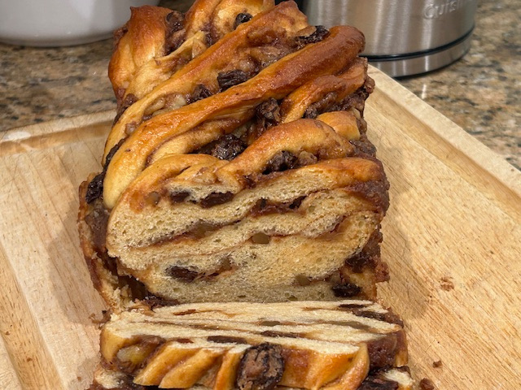
Cinnamon
Babka
for the beginning baker

Slide 2
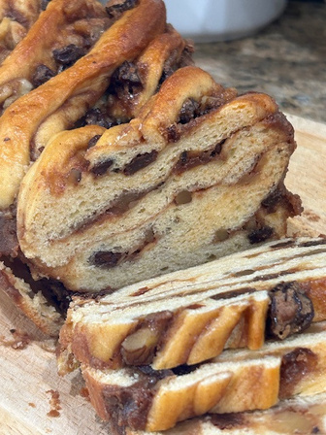
BABKA
A babka is a sweet, yeast-risen bread that is made by rolling out dough, spreading it with a sweet filling, and then rolled up and braided before being baked. Babkas originated in Poland and the Jewish communities of Eastern Europe as a way to use up extra challah dough. The extra dough was rolled out, spread with a fruit filling or cinnamon, and then shaped and baked alongside the challah.
In the mid-19th century, babkas began to appear in European-style bakeries in Israel before being brought to the United States by Jewish immigrants. Here, new babka fillings such as poppy seed and chocolate began to appear. By the 1970's babkas became famous in the Ashkanazi communities in New York City, and the loaves began to take on the appearance of a braided loaf, rather than the flatter, more rectangular versions common in Israel.
Today, the babka continues to rise in popularity throughout the United States, and can be found in most Jewish-American bakeries.

Slide 3
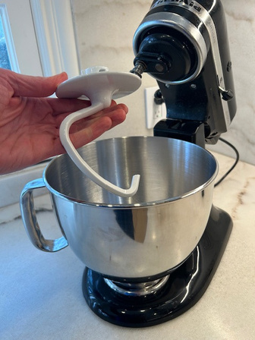
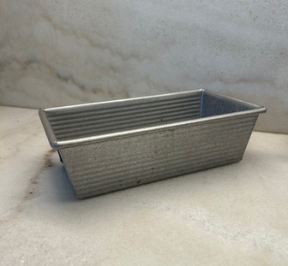
GET STARTED
Babkas are delicious, visually impressive and look complicated to make. However, with a few standard kitchen tools and patience, a babka can easily be made by a beginning baker. Most of the ingredients can be found right in your pantry! Once you feel comfortable with this recipe, you can vary the filling to anything you want, from poppy seeds to chocolate...your imagination is the only limit.
Now, it’s time to make a cinnamon babka. Before you start, make sure you have the right equipment. You will need:
  Standard electric mixer with dough hook
  Medium bowl
  Large bowl
  Rolling pin
  Offset spatula
  Large kitchen knife or bench scraper
  Nonstick cooking spray
Now, you’re ready to gather your ingredients and follow the recipe instructions below. Good luck!
Mixer with dough hook
  8 1/2" x 4 1/2" loaf pan
  Plastic wrap
  Pastry brush (optional)
  Measuring cups and measuring spoons
  Cooling rack
  ...and an oven, of course.
Loaf pan

Slide 4
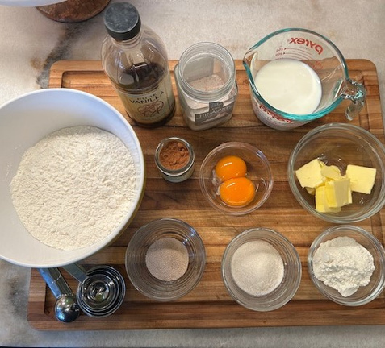
INGREDIENTS
Dough
  3/4 cup whole milk, at room temperature (6 oz)
  2 large egg yolks
  1 teaspoon vanilla extract
  2 cups all-purpose flour (10 oz)
  2 tablespoons potato flour
  2 tablespoons sugar
  1/2 teaspoon cinnamon
  1 teaspoon instant or rapid-rise yeast
  1 teaspoon table salt
  4 tablespoons unsalted butter, softened (2 oz)

Slide 5
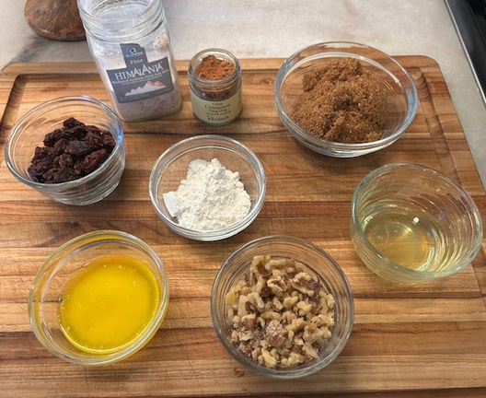
Filling
  1/2 cup packed light brown sugar (3.5 oz)
  2 1/2 tablespoons all-purpose flour
  2 tablespoons unsalted butter, melted and cooled
  1 large egg white
  2 teaspoons ground cinnamon
  1/8 teaspoon table salt
  1/3 cup walnuts, toasted and chopped (optional)
  1/3 cup raisins (optional)
Glaze
  1 large egg, beaten lightly with 1 tablespoon water

Slide 6
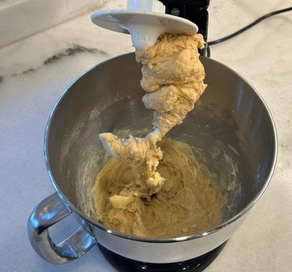
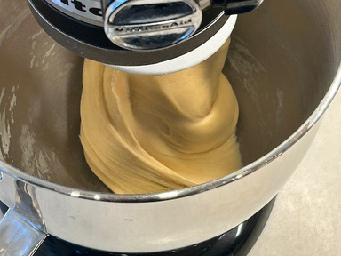
PREPARE THE DOUGH
1. Grease a large bowl with nonstick cooking spray or butter.
2. Whisk the milk, egg yolks, and vanilla together in a 1-cup liquid measuring cup.
3. Using stand mixer fitted with dough hook, mix the flour, potato flour (if using), sugar, yeast, cinnamon, and salt on low speed until combined. Slowly add the milk mixture and mix until dough comes together, about 2-3 minutes. Add a little water, 1 teaspoon at a time, if the dough appears dry.
4. Increase speed to medium-low. Cut the butter into 8 pieces and add the butter, 1 piece at a time, until incorporated, about 1 minute. Continue to mix until the dough is smooth and comes away from the sides of the bowl. This could take anywhere from 8 to 12 minutes.
Dough should appear shaggy when the dough comes together.
Home
Stop mixing when the dough comes away from the bowl and is smooth.

Slide 7
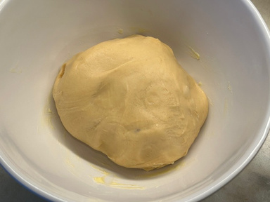
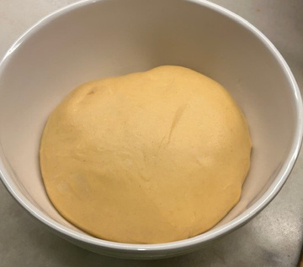
5. Transfer the dough to the greased bowl, cover with plastic wrap, and place on a counter at room temperature until it has doubled in size. This could take 1-2 hours.
6. Place the dough into the refrigerator until firm, about 1 hour. This makes the dough much easier to roll out and shape. While the dough is chilling, prepare the filling.
Dough before rising.
PREPARE THE FILLING
Home
1. Combine all of the filling ingredients except for the raisins and walnuts (if using) in a medium bowl. Keep the walnuts and raisins separate until shaping the loaf.
After rising, the dough should be roughly double in size.

Slide 8
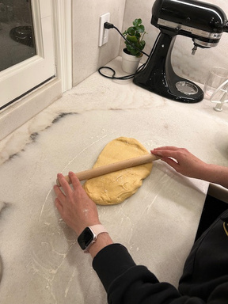
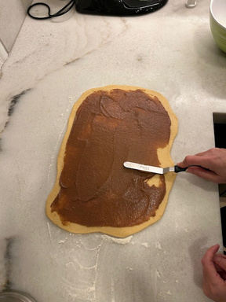
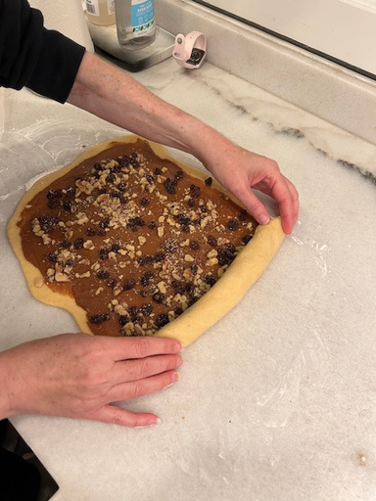
SHAPE THE DOUGH
1. Spray an 8½ by 4½-inch loaf pan with nonstick spray.
2. Remove the dough from the refrigerator, uncover, and scrape the dough from the bowl onto a lightly floured counter.
3. Using a rolling pin, roll the dough out to a 16" x10" rectangle (this is approximate...it does not need to be exact).
4. Using an offset spatula, spread the filling over the dough, leaving a ½-inch border around edges. If using walnuts and raisins, scatter them over the filling.
5. Beginning with one of the short sides, roll up the dough into a log and pinch the long seam to seal so that the log doesn’t unroll.
Roll out the dough.
Spread the filling.
Roll into a log.

Slide 9
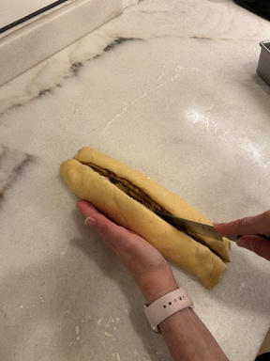
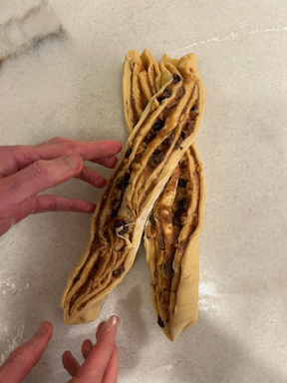
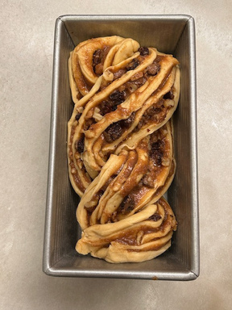
6. Place the log with the long seam down. With a sharp knife, cut the dough in half lengthwise, from one end to the other.
7. Place the 2 half-logs next to each other with the cut sides face up. It will seem a little messy, but will turn out fine!
8. Keeping the cut sides face up, braid the 2 half-logs together.
9. Place the shaped loaf into the prepared loaf pan and cover with plastic wrap.
10. Let the shaped loaf rise for 45-60 minutes, until the loaf rises above the rim of the pan.
Slice the log in half.
Braid the half-logs.
Place shaped loaf into pan.

Slide 10
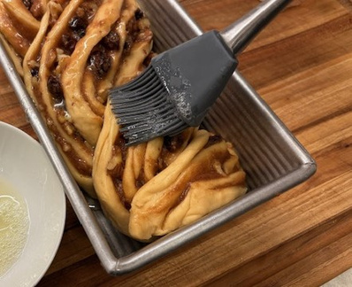
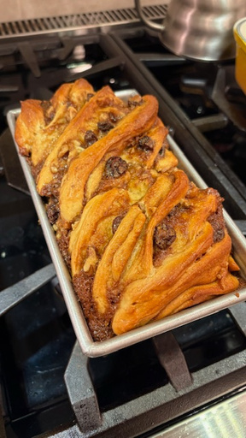
BAKE THE BABKA
1. Heat oven to 350 degrees.
2. Remove the loaf from oven and discard plastic. Brush the loaf with egg glaze (use a pastry brush if you have one).
3. Place the loaf in the oven and bake until deep golden brown, about 40 minutes. If you have a food thermometer, insert it into the loaf...the center should read 185 degrees. Check the loaf halfway through baking and cover with foil if it’s browning too quickly!!
4. Let the loaf cool in pan on wire rack for 20 minutes. Remove the loaf from the pan and cool completely, about 2 hours.
5. Serve.
Brush with the egg glaze.
Bake until deep golden brown.

Slide 11
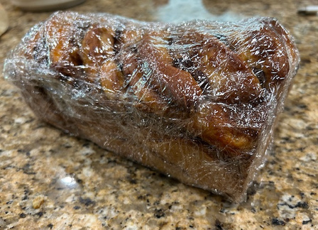
STORAGE INFORMATION
Loaf can be stored at room temperature, well-wrapped, for several days.
Freeze for longer storage.

Slide 12
  Lowfat milk can be used instead of whole milk.
  Liquids should be at room temperature. If liquids are cold, leave at room temperature for 1 hour, or microwave for 10 seconds.
  When appropriate, ingredient weights are provided in addition to volume. Weighing ingredients is more accurate and preferred. However, the bread will still be delicious if ingredients are measured with measuring cups and spoons.
  Bread flour may be used instead of all-purpose flour.
  If potato flour is not available, substitute additional all-purpose flour instead.
  To soften butter, leave at room temperature for at least 1 hour, or microwave for 10 seconds.
INGREDIENT NOTES

Slide 13
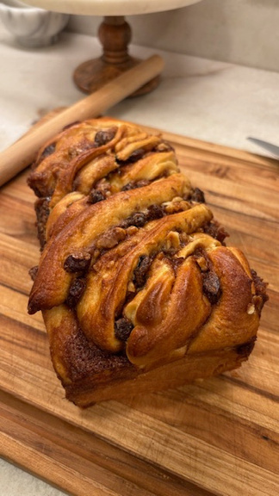
ADDITIONAL NOTES
  The dough may still be a bit sticky when it is done being kneaded. What’s important is that the dough appears much smoother than it did before it was kneaded.
  Your dough will rise faster in warmer temperatures, slower in cooler temperatures.
  If an offset spatula is not available, a knife can be used instead.

